Slide 1
New approach to productivity
Prepared by:
Ablaikhan Aimbetov

Slide 2
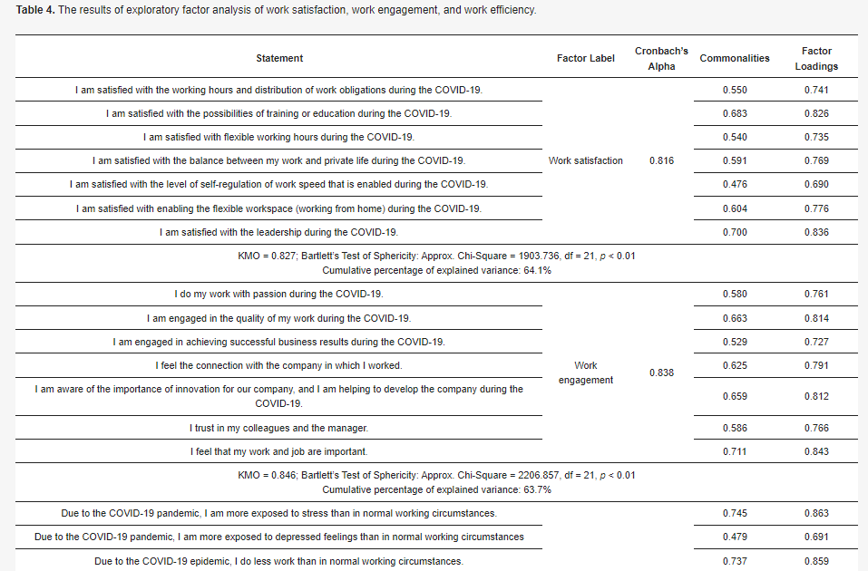
Background
Gender Differences in Work Satisfaction, Work Engagement and Work Efficiency of Employees during the COVID-19 Pandemic: The Case in Slovenia (6 August, 2021)
https://www.mdpi.com/2071-1050/13/16/8791/htm

Slide 3
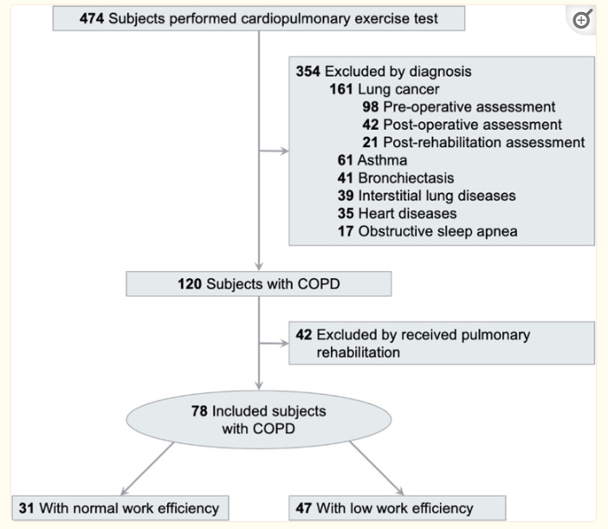
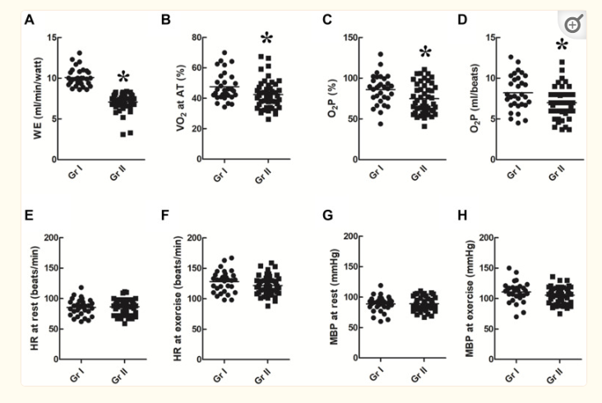
Background
2. Poor Work Efficiency is Associated with Poor Exercise Capacity and Health-Related Quality of Life in Patients with Chronic Obstructive Pulmonary Disease (10 February, 2021)
https://www.ncbi.nlm.nih.gov/pmc/articles/PMC7882460/

Slide 4
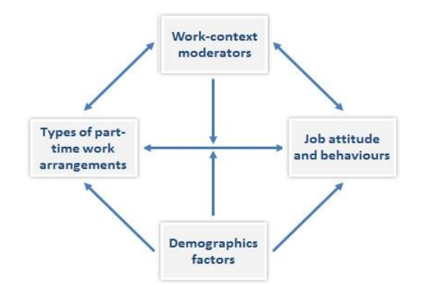
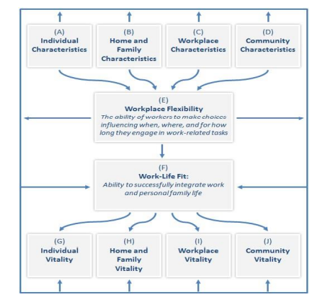
Background
3. The Impact of Part-Time and Full-Time Work on Employees' Efficiency the Importance of
Flexible Work Arrangements (7 July, 2021)
https://www.researchgate.net/profile/Kalyan-Chakravarthi-3/publication/354269686_The_Impact_of_Part-Time_and_Full-Time_Work_on_Employees'_Efficiency_the_Importance_of_Flexible_Work_Arrangements/links/6263a371bca601538b60d35a/The-Impact-of-Part-Time-and-Full-Time-Work-on-Employees-Efficiency-the-Importance-of-Flexible-Work-Arrangements.pdf

Slide 5


Why Mark Zuckerberg and Sundar Pichai Are Worried About Productivity
Mark Zuckerberg and Sundar Pichai have highlighted that tech companies probably have way too many employees, so many that there are people in these companies who are not working and are just chilling. While Pichai said this in a subtle way, Zuckerberg said recently, there are a "bunch of people at the company who shouldn't be here."
Source: www.theinformation.com

Slide 6
Hypothesis
Propose to calculate the productivity of employees and their contribution to the company, based on their behavior during the working day, as well as to identify the relationships between social indicators (gender, age, physical health) and employees performance

Slide 7
Assumptions
How a worker’s mental lapses or physical accidents may indicate that he or she is becoming sick and may soon miss a day of work due to illness
How workers’ Efficacy is influenced by the day of the week, day of the month, and month of the year
How workers’ age impacts their average daily Efficacy
How workers’ average daily Efficacy is influenced by the difference in age between them and their supervisor
How a worker’s average daily Efficacy is influenced by whether he or she is working primarily with teammates of the same or opposite sex
How workers can be classified into groups with high, moderate, or low daily Efficacy that is either relatively stable or highly variable

Slide 8
Dataset
Types of observations
Presence | Absence
Efficacy | Disruption
Feat | Resignation
Slip | None
Sacrifice | Onboarding
Lapse | Sabotage
Idea | Teamwork
42 columns
411,948+ rows
14 types of observations
687 persons
Source: https://www.kaggle.com/datasets/gladdenme/factory-workers-daily-performance-attrition-s

Slide 9
Events classification
GROUP 1 | GROUP 2 | GROUP 3
Onboarding | Sacrifice | Sabotage
Termination | Teamwork | Disruption
Resignation | Idea | Slip
Presence | Feat | Lapse
Efficacy

Slide 10
sub_ID | Employee ID number for the worker who is the subject of the event reflected in a row.
text_formatsub_fname | The first name of the event’s subject.
text_formatsub_lname | The last name of the event’s subject.
grid_3x3sub_age | The age of the event’s subject.
text_formatsub_sex | The sex (“M” or “F”) of the employee who is the event’s subject.
text_formatsub_shift | The name of the shift on which the event’s subject works. Possible values are “Shift 1”, “Shift 2”, “Shift 3”, or “unassigned” (for the factory’s lone Production Director, who isn’t assigned to a single shift but instead oversees all of the shifts).
text_formatsub_team | The name of the team on which the event’s subject works. For an employee working on Shift 1, possible values are “Team 1” through “Team 8” (for persons filling the role of Team Leader or Laborer) or “unassigned” (for the Shift Manager, who isn’t assigned to a single team but instead oversees all of the shift’s teams). Similarly, Shift 2 includes “Team 9” through “Team 16”, and Shift 3 includes “Team 17” through “Team 24”. The factory’s three Shift Managers and one Production Director also have “unassigned” as a value, as they aren’t members of a particular team.
text_formatsub_role | The organizational role of the employee who is the event’s subject. Values include “Production Director,” of which there is exactly 1; “Shift Manager,” of which there are 3; “Team Leader,” of which there are 24; and “Laborer,” of which there are 480.
text_formatsub_coll_IDs | A list containing the ID numbers of the other employees who are immediate coworker-peers of the event’s subject. For a Laborer, this includes the other Laborers serving in the same team at the moment when the event occurred; for a Team Leader, it includes the other seven Team Leaders who were working on the same Shift; for a Shift Manager, it includes the other two Shift Managers; and for the Production Director, the value is “None”. Because Laborers and Team Leaders can quit or be terminated (and replaced) during the course of the simulated time period, the ID numbers of a subject’s colleagues might change from one day to the next.
text_formatsub_colls_same_sex_prtn | A float representing the portion of the subject’s immediate coworker-peers who are of the same sex. (E.g., a female Team Leader who has 4 female and 3 male coworker-peers will have a value of ≈0.5714.) If the subject is the factory’s Production Director (who has no coworker-peers), the value is “None”.
grid_3x3sub_health_h | A float between 0.0 and 1.0 representing the (hidden) Health stat of the event’s subject.

Slide 11
Due to big size of the dataset I represented just small part of it, also we can’t upload it to Git (size > 100 Mb). For details, please, refer to the link on page 4

